Slide 1
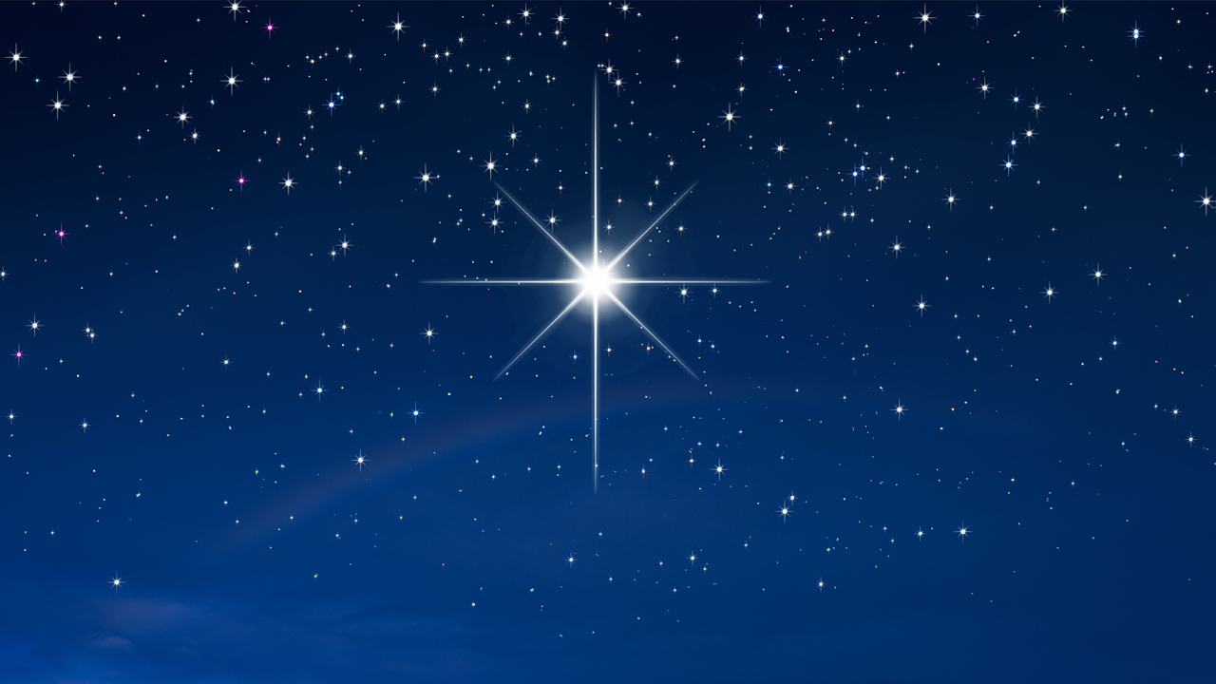
Messiah! Bright Morning Star

Slide 2
There shall come a Star out of Jacob
A Ruler shall rise out of Israel
A King shall reign and execute justice
A High Priest shall come out of
Bethlehem
Er zal een Koning worden geboren in Bethlehem, die zal regeren met gerechtigheid.

Slide 3
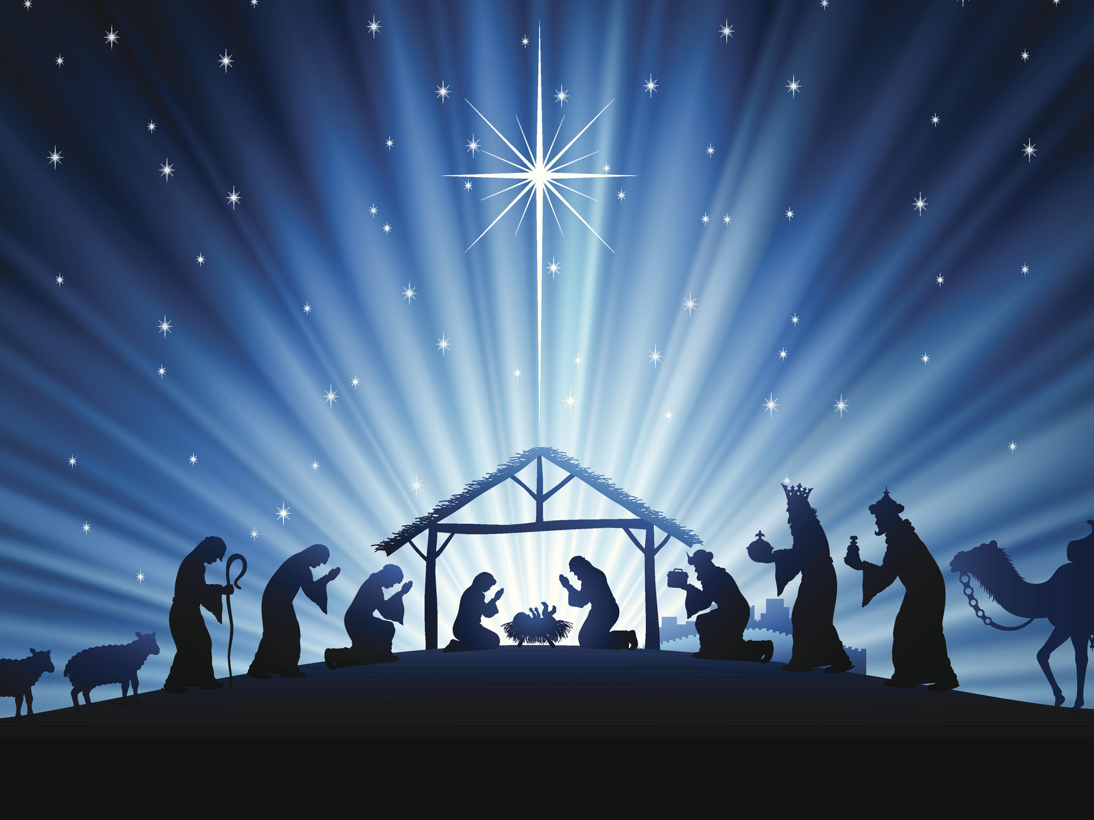
Messiah! Messiah!
Messiah! Bright Morning Star! (2x)
Messias! Heldere Morgenster!

Slide 4
Bright Morning Star, we long to see
Your appearance in the east
Shining in glory! Blazing with triumph!
We will rise to worship You
Heldere Morgenster, schijnend in al Zijn glorie
Wij zullen Hem aanbidden

Slide 5
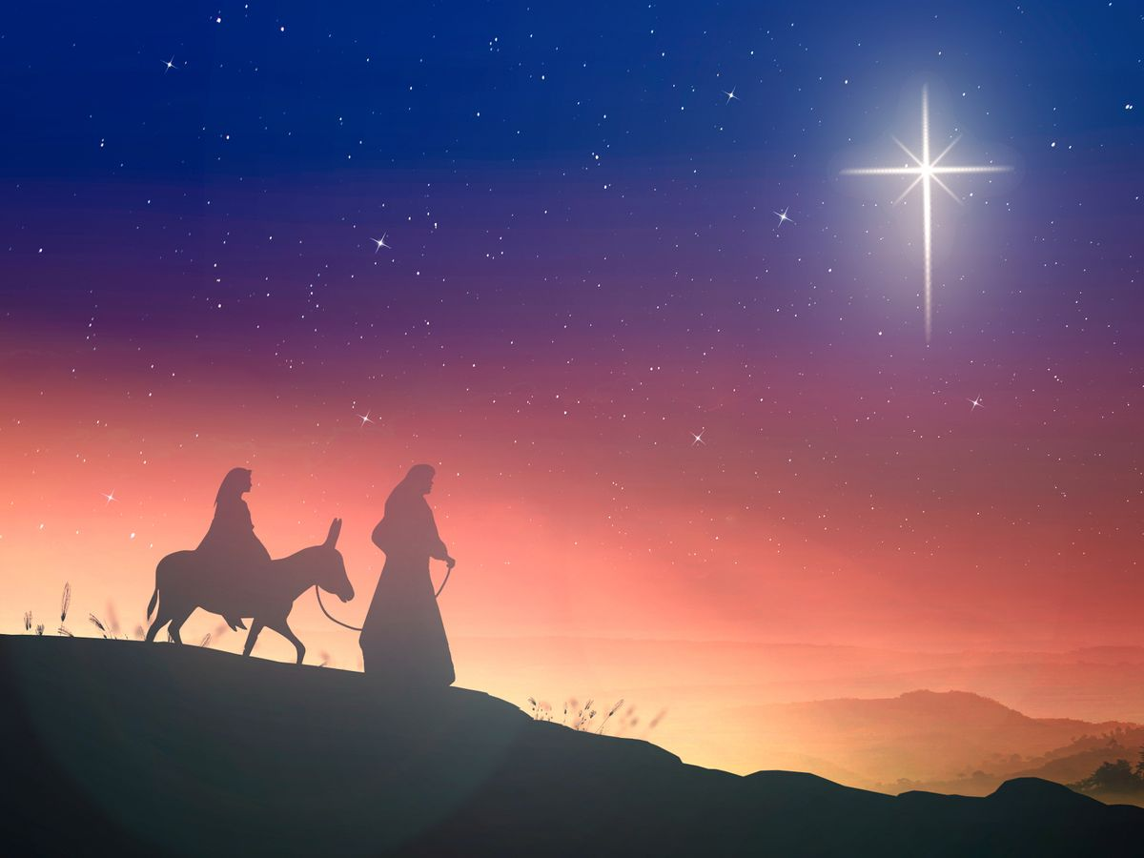
Messiah! Messiah!
Messiah! Bright Morning Star!
…
Messias! Heldere Morgenster!
*

